Slide 1
Fundamentals of Computer Networks and Management
Atul Kahate

Slide 2
Sessions 1 and 2

Slide 3
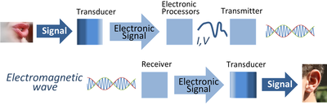
Electronic Communication System

Slide 4
Introduction to Communication System
Communication system allows exchange of data between two stations, transmitter and receiver
Signals pass from source to destination through what is called channel, which represents a way that signal use it to move from source toward destination
To transmit signals in communication system, it must be first processed in several stages, beginning from signal representation, to signal shaping until encoding and modulation
After preparing the transmitted signal, it is passed to the transmission line of channel
Due to the signal crossing this media it faces many impairments such as noise, attenuation and distortion

Slide 5
Components of a Data Communication System
Message
The data/information to be transmitted. It can be in the form of text, audio, video, photos, or combination of them.
Transmission device or sender
A device that actually sends out the message.(eg computer , telephone, etc).
A medium
A physical channel where the information travels from the sender to the receiver.
Receiving device or receiver
A device that receives the message then process the information in the message.

Slide 6
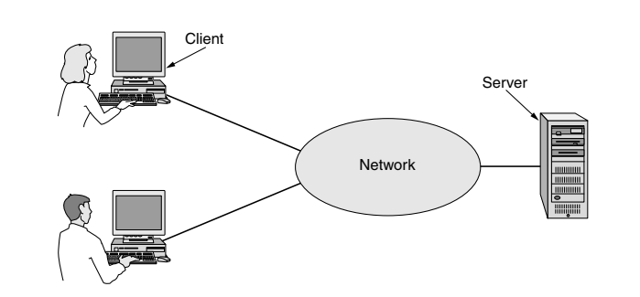
Client-Server Model

Slide 7
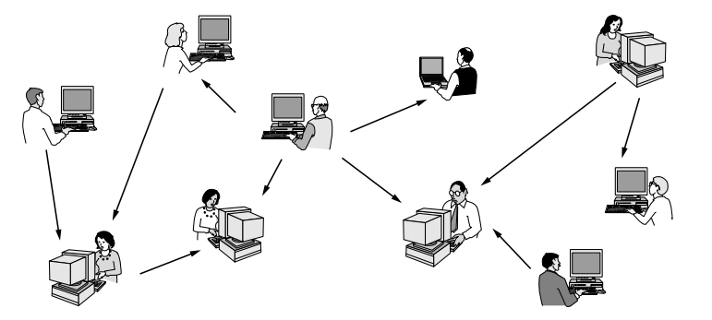
Peer-to-Peer (P2P) System

Slide 8
Sessions 3 and 4

Slide 9
Network Hardware and Software
There are two types of transmission technology: broadcast links and point-to-point links. (See next slide)
Point-to-point links connect individual pairs of machines. To go from the source to the destination on a network made up of point-to-point links, short messages, called packets, may have to first visit one or more intermediate machines. Often multiple routes, of different lengths, are possible, so finding good ones is important in point-to-point networks. Point-to-point transmission with exactly one sender and exactly one receiver is sometimes called unicasting.
In contrast, on a broadcast network, the communication channel is shared by all the machines on the network; packets sent by any machine are received by all the others. An address field within each packet specifies the intended recipient. Upon receiving a packet, a machine checks the address field. If the packet is intended for the receiving machine, that machine processes the packet; if the packet is intended for some other machine, it is just ignored. A wireless network is a common example of a broadcast

Slide 10
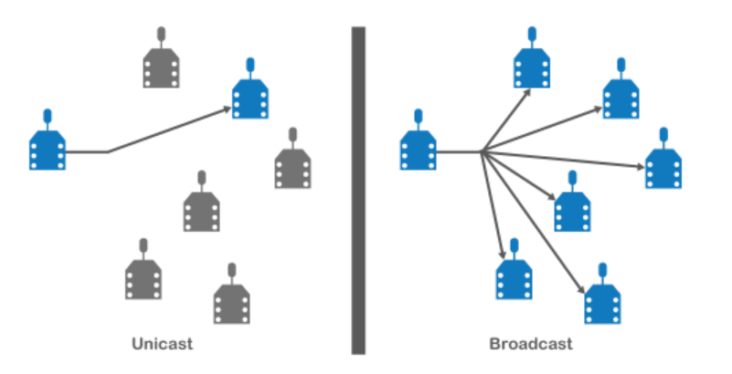
Unicast versus Broadcast

Slide 11
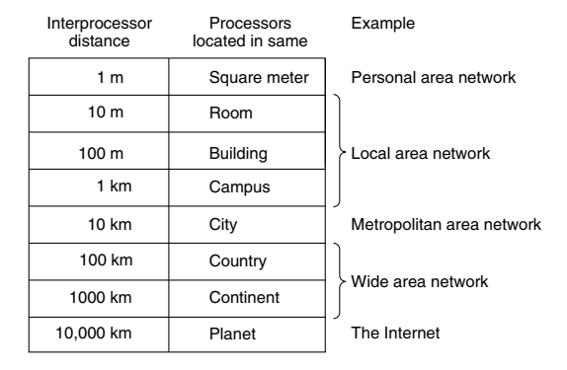
Scale and Network Types

Slide 12
Personal Area Network (PAN)
A Personal Area Network (PAN) lets devices communicate over the range of a person
A common example is a wireless network that connects a computer with its peripherals
Some companies got together to design a short-range wireless network called Bluetooth to connect these components without wires
The idea is that if your devices have Bluetooth, then you need no cables
In the simplest form, Bluetooth networks use the master-slave concept
The system unit is the master and keyboard, etc., are slaves
The master tells the slaves what addresses to use, when they can broadcast, etc. (See figure)

Slide 13
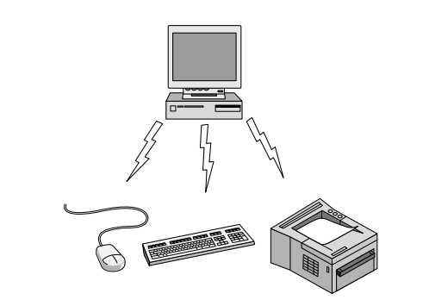
Bluetooth

Slide 14
Local Area Network (LAN)
A Local Area Network (LAN) is a privately owned network that operates within a single building like a home, office or factory
LANs are widely used to connect personal computers and consumer electronics to let them share resources (e.g., printers) and exchange information
Wireless LANs are very popular these days, especially in homes, older office buildings, cafeterias, and other places where it is too much trouble to install cables
In these systems, every computer has a radio modem and an antenna that it uses to communicate with other computers

Slide 15
More on LAN …
In most cases, each computer talks to a device called as Access Point (AP), wireless router, or base station
This device relays packets between the wireless computers and also between them and the Internet
If other computers are close enough, they can communicate directly with one another in a peer-to-peer configuration.
There is a standard for wireless LANs called IEEE 802.11, popularly known as WiFi, which has become very widespread

Slide 16
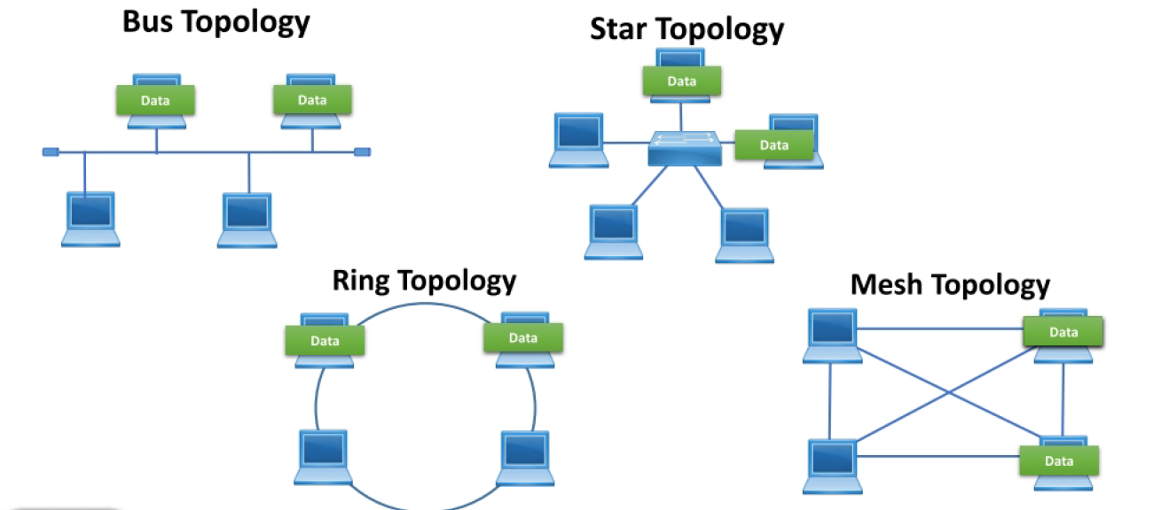
LAN Topology

Slide 17
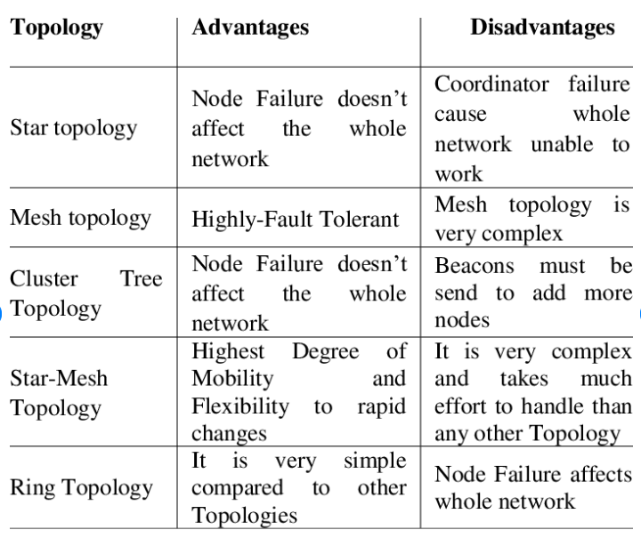
Comparison

Slide 18
Setting up a network
Network Interface Card (NIC)
Transmission media
Network devices

Slide 19
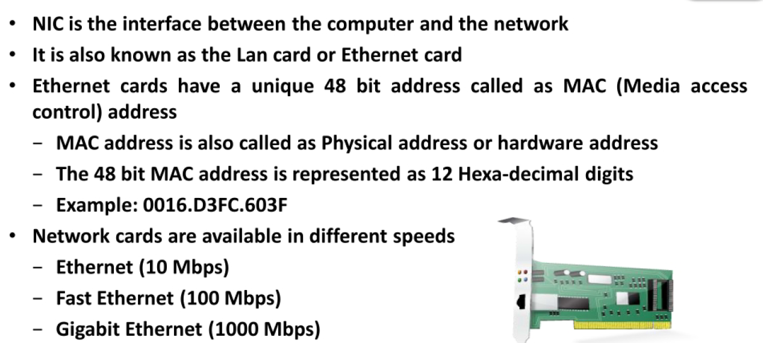
Network Interface Card (NIC)

Slide 20
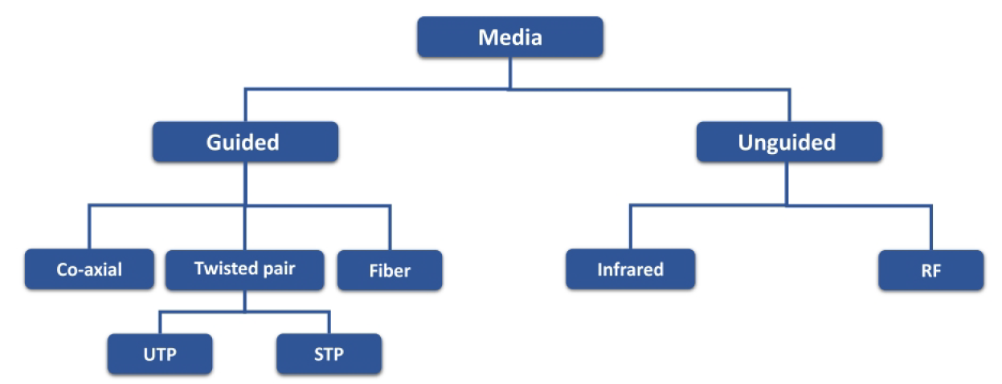
Transmission media

Slide 21
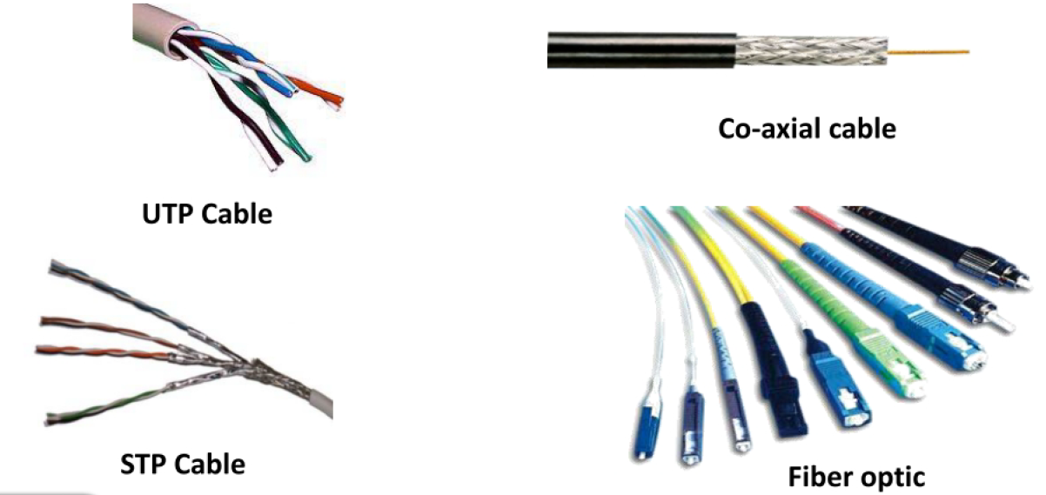
Transmission media

Slide 22
Transmission Media
A transmission medium can be broadly defined as anything that can carry information from a source to a destination
For example, the transmission medium for two people having a dinner conversation is the air
In data communications the definition of the information and the transmission medium is more specific
Transmission media can be divided into two broad categories:
Guided media (Wired) include twisted-pair cable (uses electric current), coaxial cable (uses electric current), fiber-optic cable (uses light)
Unguided medium (Wireless) is free space

Slide 23
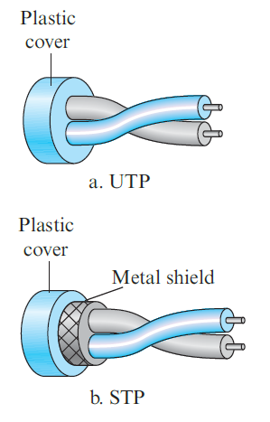
Twisted-pair cable
A twisted pair consists of two conductors (normally copper), each with its own plastic insulation, twisted together
One of the wires is used to carry signals to the receiver, and the other is used only as a ground reference
The receiver uses the difference between the two
In addition to the signal from the sender, interference (noise) and crosstalk may affect both wires and create unwanted signals
If the two wires are parallel, the effect of these unwanted signals is not the same in both wires because they are at different locations relative to the noise or crosstalk sources
This results in a difference at the receiver
By twisting the pairs, a balance is maintained

Slide 24
UTP and STP
The most common twisted-pair cable used in communications is referred to as unshielded twisted-pair (UTP)
IBM has also produced a version of twisted-pair cable for its use called shielded twisted-pair (STP)
STP cable has a metal foil or braided-mesh covering that encases each pair of insulated conductors
Although metal casing improves the quality of cable by preventing the penetration of noise or crosstalk, it is bulkier and more expensive
Twisted-pair cables are used in telephone lines to provide voice and data channels
The local loop—the line that connects subscribers to the central telephone office—commonly uses twisted-pair cables

Slide 25
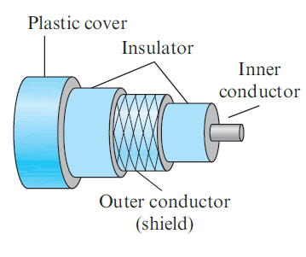
Coaxial cables
Coaxial cable (or coax) carries signals of higher frequency ranges than those in twisted-pair cable
Instead of having two wires, coax has a central core conductor of solid or stranded wire (usually copper) enclosed in an insulating sheath, which is, in turn, encased in an outer conductor of metal foil, braid, or a combination of the two
The outer metallic wrapping serves both as a shield against noise and as the second conductor, which completes the circuit
This outer conductor is also enclosed in an insulating sheath, and the whole cable is protected by a plastic cover

Slide 26
Coaxial cable – Usage
Coaxial cable was widely used in analog telephone networks where a single coaxial network could carry 10,000 voice signals
Later it was used in digital telephone networks where a single coaxial cable could carry digital data up to 600 Mbps
However, coaxial cable in telephone networks has largely been replaced today with fiber-optic cable
Cable TV networks also use coaxial cable
In the traditional cable TV network, the entire network used coaxial cable
Later, however, cable TV providers replaced most of the media with fiber-optic cable; hybrid networks use coaxial cable only at the network boundaries, near the consumer premises
Another common application of coaxial cable is in traditional Ethernet LANs
Because of its high bandwidth, and consequently high data rate, coaxial cable was chosen for digital transmission in early Ethernet LANs

Slide 27
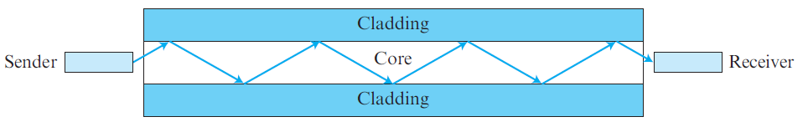
Fiber-optic cable
A fiber-optic cable is made of glass or plastic and transmits signals in the form of light
Optical fibers use reflection to guide light through a channel
A glass or plastic core is surrounded by a cladding of less dense glass or plastic
The difference in density of the two materials must be such that a beam of light moving through the core is reflected off the cladding instead of being refracted into it

Slide 28
Fiber-optic usage
Fiber-optic cable is often found in backbone networks because its wide bandwidth is cost-effective
Some cable TV companies use a combination of optical fiber and coaxial cable, thus creating a hybrid network
Optical fiber provides the backbone structure while coaxial cable provides the connection to the user premises
This is a cost-effective configuration since the narrow bandwidth requirement at the user end does not justify the use of optical fiber
Local-area networks such as 100Base-FX network (Fast Ethernet) and 1000Base-X also use fiber-optic cable
The 10-Gigabit Ethernet operation also uses fiber-optic cable

Slide 29
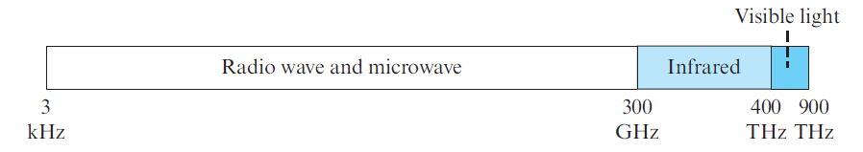
Unguided media
Unguided media transport electromagnetic waves without using a physical conductor
This type of communication is often referred to as wireless communication
Signals are normally broadcast through free space and thus are available to anyone who has a device capable of receiving them
The part of the electromagnetic spectrum, ranging from 3 kHz to 900 THz is used for wireless communication.

Slide 30
Unguided signals
Unguided signals can travel from source to destination in several ways:
Ground propagation: Radio waves travel through the lowest portion of the atmosphere, hugging the earth. These low-frequency signals emanate in all directions from the transmitting antenna and follow the curvature of the planet. Distance depends on the amount of power in the signal: The greater the power, the greater the distance.
Sky propagation: Higher-frequency radio waves radiate upward into the ionosphere (the layer of atmosphere where particles exist as ions) where they are reflected back to earth. This type of transmission allows for greater distances with lower output power.
Line-of-sight propagation: Very high-frequency signals are transmitted in straight lines directly from antenna to antenna. Antennas must be directional, facing each other, and either tall enough or close enough together not to be affected by the curvature of the earth. Line-of-sight propagation is tricky because radio transmissions cannot be completely focused.

Slide 31
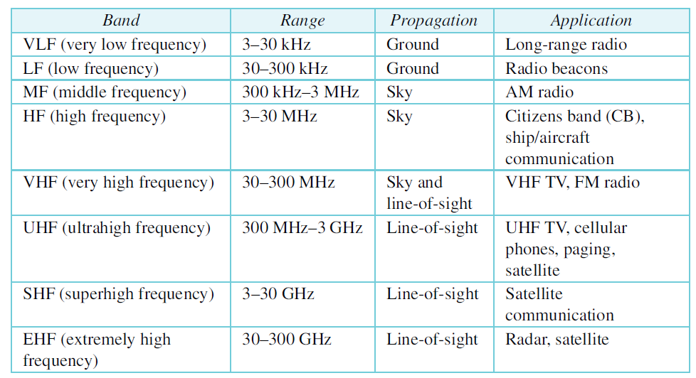
Electromagnetic spectrum

Slide 32
Classification of Wireless communication
Radio waves
Microwaves
Infrared waves

Slide 33
Radio waves
Electromagnetic waves ranging in frequencies between 3 kHz and 1 GHz are normally called radio waves; waves ranging in frequencies between 1 and 300 GHz are called microwaves
However, the behavior of the waves, rather than the frequencies, is a better criterion for classification
Radio waves are omnidirectional
When an antenna transmits radio waves, they are propagated in all directions. This means that the sending and receiving antennas do not have to be aligned. A sending antenna sends waves that can be received by any receiving antenna.
The omnidirectional property has a disadvantage, too. The radio waves transmitted by one antenna are susceptible to interference by another antenna that may send signals using the same frequency or band.
Radio waves, particularly those waves that propagate in the sky mode, can travel long distances
This makes radio waves a good candidate for long-distance broadcasting such as AM radio
Radio waves, particularly those of low and medium frequencies, can penetrate walls. This characteristic can be both an advantage and a disadvantage. It is an advantage because, an AM radio can receive signals inside a building. It is a disadvantage because we cannot isolate a communication to just inside or outside a building.
The radio wave band is relatively narrow, just under 1 GHz, compared to the microwave band

Slide 34
Radio waves
Electromagnetic waves ranging in frequencies between 3 kHz and 1 GHz are normally called radio waves; waves ranging in frequencies between 1 and 300 GHz are called microwaves
However, the behavior of the waves, rather than the frequencies, is a better criterion for classification
Radio waves are omnidirectional
When an antenna transmits radio waves, they are propagated in all directions. This means that the sending and receiving antennas do not have to be aligned. A sending antenna sends waves that can be received by any receiving antenna.
The omnidirectional property has a disadvantage, too. The radio waves transmitted by one antenna are susceptible to interference by another antenna that may send signals using the same frequency or band.
Radio waves, particularly those waves that propagate in the sky mode, can travel long distances
This makes radio waves a good candidate for long-distance broadcasting such as AM radio
Radio waves, particularly those of low and medium frequencies, can penetrate walls. This characteristic can be both an advantage and a disadvantage. It is an advantage because, an AM radio can receive signals inside a building. It is a disadvantage because we cannot isolate a communication to just inside or outside a building.
The radio wave band is relatively narrow, just under 1 GHz, compared to the microwave band

Slide 35
Microwaves
Electromagnetic waves having frequencies between 1 and 300 GHz are called microwaves
Microwaves are unidirectional. When an antenna transmits microwaves, they can be narrowly focused. This means that the sending and receiving antennas need to be aligned. The unidirectional property has an obvious advantage. A pair of antennas can be aligned without interfering with another pair of aligned antennas.
Microwave propagation is line-of-sight. Since the towers with the mounted antennas need to be in direct sight of each other, towers that are far apart need to be very tall.
The curvature of the earth as well as other blocking obstacles do not allow two short towers to communicate by using microwaves.
Repeaters are often needed for long distance communication.
Very high-frequency microwaves cannot penetrate walls. This characteristic can be a disadvantage if receivers are inside buildings.
Microwaves, due to their unidirectional properties, are very useful when unicast (one-to-one) communication is needed between the sender and the receiver. They are used in cellular phones, satellite networks, and wireless LANs.

Slide 36
Infrared
Infrared waves, with frequencies from 300 GHz to 400 THz (wavelengths from 1 mm to 770 nm), can be used for short-range communication
Infrared waves, having high frequencies, cannot penetrate walls. This advantage prevents interference between one system and another; a short-range communication system in one room cannot be affected by another system in the next room.
When we use our infrared remote control, we do not interfere with the use of the remote by our neighbors
However, this same characteristic makes infrared signals useless for long-range communication
In addition, we cannot use infrared waves outside a building because the sun’s rays contain infrared waves that can interfere with the communication

Slide 37
Wired LAN - Ethernet

Slide 38
What is Ethernet?
In the 1980s and 1990s several different types of LANs were used: Ethernet, Token Ring, Token Bus, and FDDI (Fiber Distribution Data Interface)
Almost every LAN except Ethernet has disappeared from the marketplace because Ethernet was able to update itself to meet the needs of the time. Main reason for its success: it could evolve with the demand for higher transmission rates.
The Ethernet LAN was developed in the 1970s by Robert Metcalfe and David Boggs.
Since then, it has gone through four generations: Standard Ethernet (10 Mbps), Fast Ethernet (100 Mbps), Gigabit Ethernet (1 Gbps), and 10 Gigabit Ethernet (10 Gbps).

Slide 39
IEEE 802
In 1985, the Computer Society of the IEEE started a project, called Project 802, to set standards to enable intercommunication among equipment from a variety of manufacturers.
Project 802 does not seek to replace any part of the OSI model or TCP/IP protocol suite.
Instead, it is a way of specifying functions of the physical layer and the data-link layer of major LAN protocols.

Slide 40
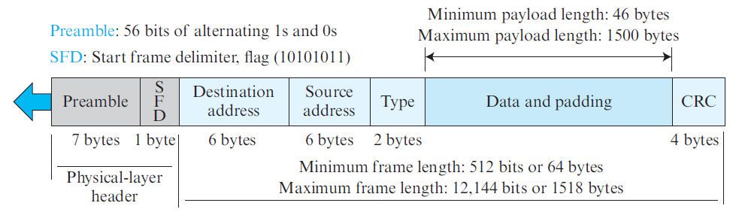
Ethernet frame format

Slide 41
Connectionless and unreliable service
Ethernet provides a connectionless service, which means each frame sent is independent of the previous or next frame.
Ethernet has no connection establishment or connection termination phases.
The sender sends a frame whenever it has it; the receiver may or may not be ready for it.
The sender may overwhelm the receiver with frames, which may result in dropping frames.
If a frame drops, the sender will not know about it.

Slide 42
Addressing
Each station on an Ethernet network (such as a PC, workstation, or printer) has its own network interface card (NIC).
The NIC fits inside the station and provides the station with a link-layer address.
The Ethernet address is 6 bytes (48 bits), normally written in hexadecimal notation, with a colon between the bytes.
For example, the following shows an Ethernet MAC address:
E4-46-B0-03-74-D2

Slide 43
CSMA/CD
Carrier sense multiple access with collision detection (CSMA/CD) augments the algorithm to handle the collision.
In this method, a station monitors the medium after it sends a frame to see if the transmission was successful. If so, the station’s job is finished.
If, however, there is a collision, the frame is sent again.
To better understand CSMA/CD, let us look at the first bits transmitted by the two stations involved in the collision. Although each station continues to send bits in the frame until it detects the collision, we show what happens as the first bits collide.

Slide 44
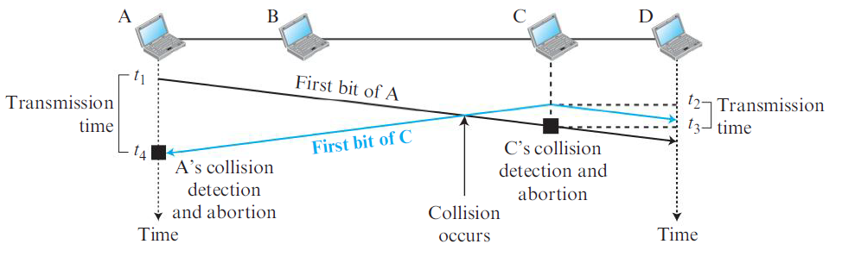
CSMA/CD

Slide 45
Modern Ethernet
Two kinds of Ethernet exist: classic Ethernet, which solves the multiple access problem using the techniques we have studied earlier; and switched Ethernet, in which devices called switches are used to connect different computers.
It is important to note that, while they are both referred to as Ethernet, they are quite different.
Classic Ethernet is the original form and ran at rates from 3 to 10 Mbps.
Switched Ethernet is what Ethernet has become and runs at 100, 1000, and 10,000 Mbps, in forms called fast Ethernet, gigabit Ethernet, and 10 gigabit Ethernet.
In practice, only switched Ethernet is used nowadays.

Slide 46
Switched Ethernet example: Gigabit ethernet
The need for an even higher data rate resulted in the design of the Gigabit Ethernet Protocol (1000 Mbps).
The IEEE committee calls the Standard 802.3z.
The goals of the Gigabit Ethernet were to upgrade the data rate to 1 Gbps, but keep the address length, the frame format, and the maximum and minimum frame length the same.
There is a central switch connected to all computers or other switches.
In this mode, for each input port, each switch has buffers in which data are stored until they are transmitted.
Since the switch uses the destination address of the frame and sends a frame out of the port connected to that particular destination, there is no collision. This means that CSMA/CD is not used.
Lack of collision implies that the maximum length of the cable is determined by the signal attenuation in the cable, not by the collision detection process.

Slide 47
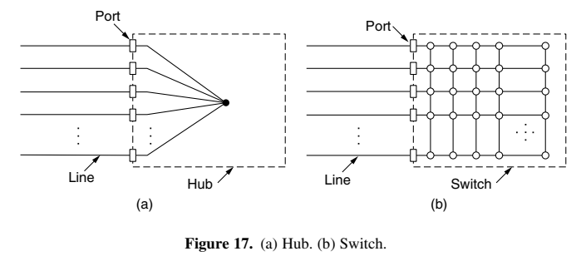
Switched Ethernet: Using hub or switch

Slide 48
Switched Ethernet - Hub
This uses a different kind of wiring pattern, in which each station has a dedicated cable running to a central hub.
Hub is a dumb device, works only at the physical layer.
Switch is intelligent, can filter frames, like bridge.
Earlier, switches were expensive. However, now we rarely see hubs. Switches are used almost everywhere.

Slide 49
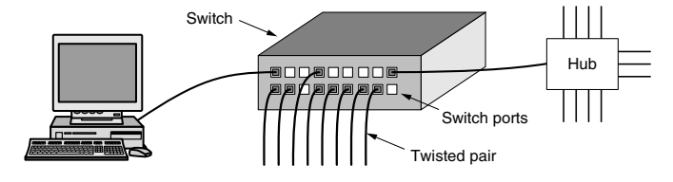
Switched Ethernet - Switch
From the outside, a switch looks just like a hub.
They are both boxes, typically with 4 to 48 ports, each with a standard RJ-45 connector for a twisted-pair cable.
If the switch itself fails, it will need to be replaced.

Slide 50
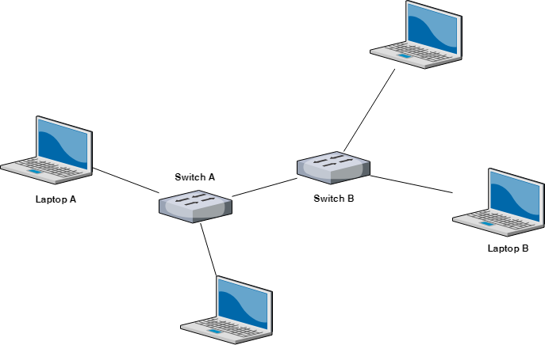
Multiple switches are used these days (Not hubs) …

Slide 51
Use of switch
Switches only output frames to the ports for which those frames are destined.
When a switch port receives an Ethernet frame from a station, the switch checks the Ethernet addresses to see which port the frame is destined for.
This step requires the switch to be able to work out which ports correspond to which addresses.
The switch then forwards the frame over its high-speed backplane to the destination port.
The destination port then transmits the frame on the wire so that it reaches the intended station. None of the other ports even knows the frame exists.

Slide 52
Virtual LAN (VLAN)

Slide 53
VLAN Basics
A station/host is considered part of a LAN if it physically belongs to that LAN.
The criterion of membership is geographic.
What happens if we need a virtual connection between two stations belonging to two different physical LANs?
We can roughly define a virtual local area network (VLAN) as a local area network configured by software, not by physical wiring.
Consider a LAN in which ten stations are grouped into three LANs that are connected by a switch. (Figure on the next slide)

Slide 54
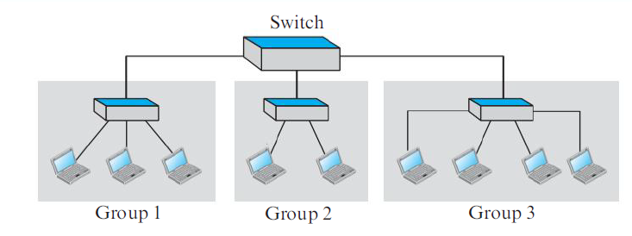
Sample LAN

Slide 55
VLAN – The need
The first three engineers work together as the first group, the next two engineers work together as the second group, and the last four engineers work together as the third group.
The LAN is configured to allow this arrangement.
But what would happen if the administrators needed to move two engineers from the first group to the third group, to speed up the project being done by the third group?
The LAN configuration would need to be changed.
The network technician must rewire.
The problem is repeated if, in another week, the two engineers move back to their previous group.
In a switched LAN, changes in the work group mean physical changes in the network configuration.
Solution: VLAN

Slide 56
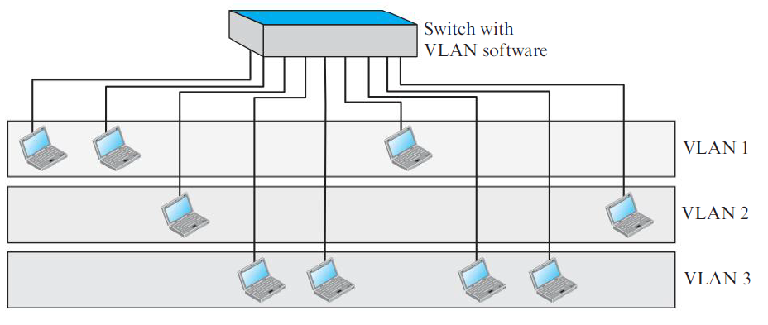
VLAN

Slide 57
How it works?
Each VLAN is a work group in the organization. If a person moves from one group to another, there is no need to change the physical configuration. The group membership in VLANs is defined by software, not hardware. Any station can be logically moved to another VLAN.
All members belonging to a VLAN can receive broadcast messages sent to that particular VLAN. This means if a station moves from VLAN 1 to VLAN 2, it receives broadcast messages sent to VLAN 2, but no longer receives broadcast messages sent to VLAN 1.
It is obvious that the problem in our previous example can easily be solved by using VLANs. Moving engineers from one group to another through software is easier than changing the configuration of the physical network.
VLAN technology even allows the grouping of stations connected to different switches in a VLAN. (See figure on the next slide)

Slide 58
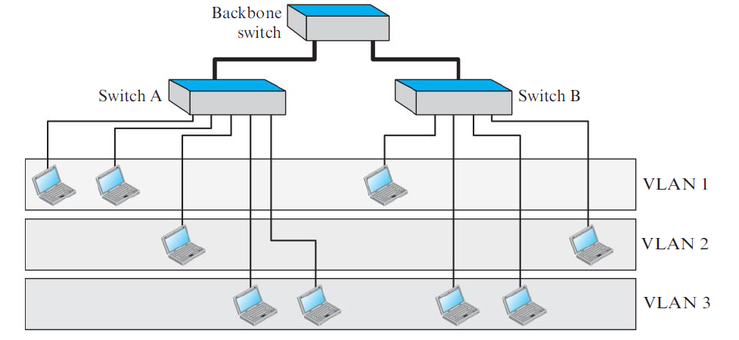
Two switches with a backbone using VLAN

Slide 59
Where can it be used?
This is a good configuration for a company with two separate buildings.
Each building can have its own switched LAN connected by a backbone.
People in the first building and people in the second building can be in the same work group even though they are connected to different physical LANs.

Slide 60
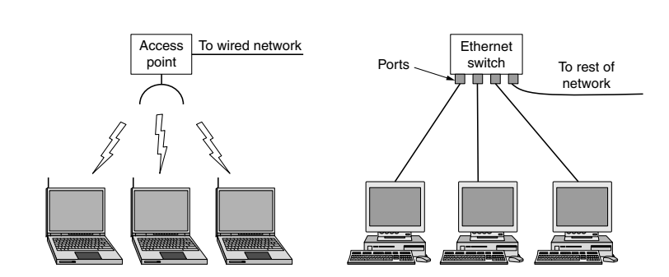
Wired and Wireless LAN

Slide 61
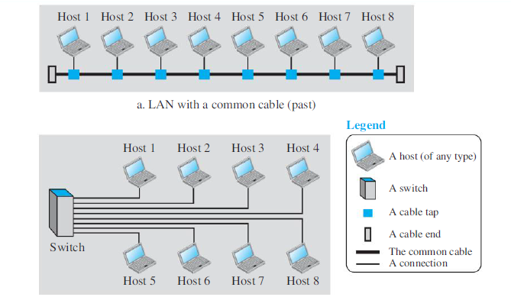
LAN – Earlier and Now

Slide 62
LAN Transmission Technologies
Wired LANs use a range of different transmission technologies
Most of them use copper wires, but some use optical fiber
LANs are restricted in size, which means that the worst-case transmission time is bounded and known in advance
Knowing these bounds helps with the task of designing network protocols
Typically, wired LANs run at speeds of 100 Mbps to 1 Gbps, have low delay (microseconds or nanoseconds), and make very few errors
Newer LANs can operate at up to 10 Gbps
In contrast, WiFi runs at speeds anywhere from 11 to hundreds of Mbps
Wired is always faster and more reliable

Slide 63
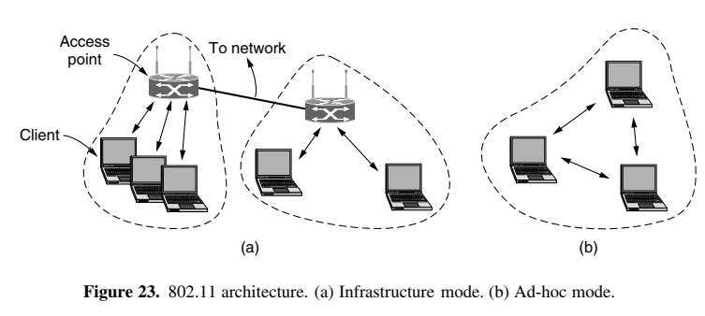
Wireless LAN

Slide 64
Wireless LAN – Infrastructure mode
802.11 networks (WiFi) can be used in two modes. The most popular mode is to connect clients such as laptops and smartphones to another network, such as the office/college network or the Internet
This is called as infrastructure mode
Each client is associated with an AP (Access Point) that is in turn connected to the other network
The client sends and receives its packets via the AP
Several access points may be connected together, typically by a wired network called a distribution system, to form an extended 802.11 network

Slide 65
Wireless LAN – Ad hoc mode
In the ad hoc network mode, we have a collection of computers that can directly send frames to each other
There is no access point
Since the Internet is the most popular application, ad hoc networks are not very popular

Slide 66
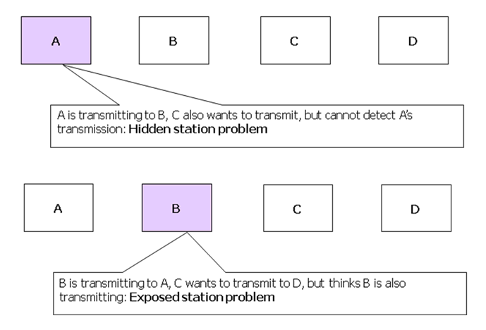
Hidden and Exposed Station Problems

Slide 67
Metropolitan Area Network (MAN)
A MAN (Metropolitan Area Network) covers a city
The best-known examples of MANs are the cable television networks available in many cities
See figure

Slide 68
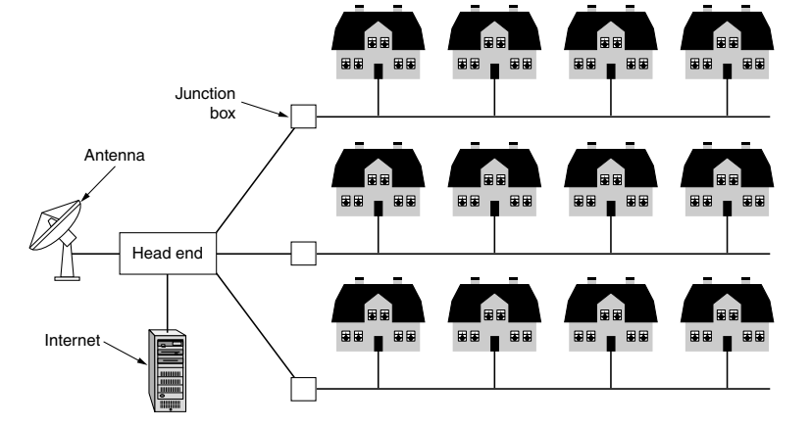
MAN

Slide 69
Wide Area Network (WAN)
A Wide Area Network (WAN) spans a large geographical area, often a country or continent
In most WANs, the network consists of two distinct components: transmission lines and switching elements
Transmission lines move bits between machines. They can be made of copper wire, optical fiber, or even radio links. Most companies do not have their own transmission lines, so instead they lease the lines from a telecommunications company.
Switching elements, or just switches, are specialized computers that connect two or more transmission lines. When data arrive on an incoming line, the switching element must choose an outgoing line on which to forward them. These switching computers have been called by various names in the past; the name router is now most commonly used. (See figure)

Slide 70
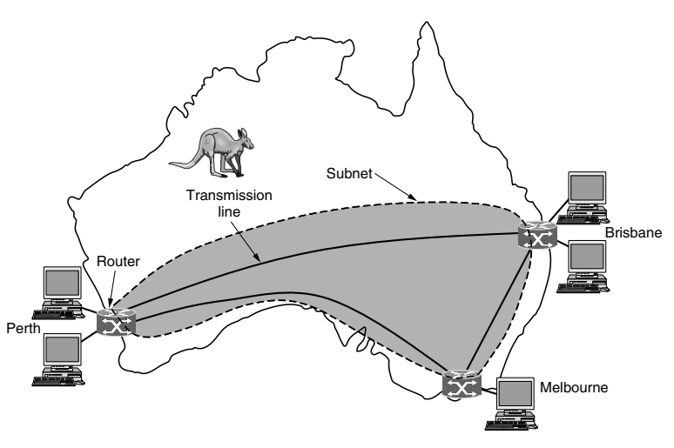
WAN

Slide 71
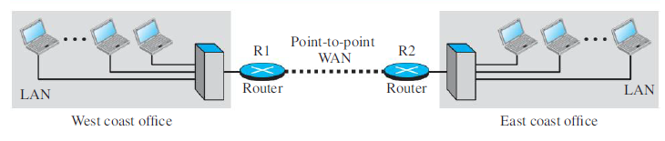
WAN Connecting LANs

Slide 72
Internetwork
Many networks exist in the world, often with different hardware and software
People connected to one network often want to communicate with people attached to a different one
The fulfillment of this desire requires that different, and frequently incompatible, networks be connected
A collection of interconnected networks is called an internetwork or internet
The general name for a machine that makes a connection between two or more networks and provides the necessary translation, both in terms of hardware and software, is a gateway

Slide 73
Protocol
Communication between two people or two devices needs to follow some protocol
A protocol is a set of rules that governs communication
For example, in a face-to-face communication between two persons, there is a set of implicit rules in each culture that define how two persons should start the communication, how to continue the communication, and how to end the communication
Similarly, in a telephone conversation, there are a set of rules that we need to follow

Slide 74
Network Software
The first computer networks were designed with the hardware as the main concern and the software as an afterthought
This strategy no longer works
Network software is now highly structured using a protocol stack
To reduce their design complexity, most networks are organized as a stack of layers or levels, each one built upon the one below it
The number of layers, the name of each layer, the contents of each layer, and the function of each layer differ from network to network
The purpose of each layer is to offer certain services to the higher layers while shielding those layers from the details of how the offered services are actually implemented
In a sense, each layer is a kind of virtual machine, offering certain services to the layer above it

Slide 75
Protocol Hierarchies
When layer n on one machine carries on a conversation with layer n on another machine, the rules and conventions used in this conversation are collectively known as the layer n protocol
Basically, a protocol is an agreement between the communicating parties on how communication is to proceed
In reality, no data are directly transferred from layer n on one machine to layer n on another machine
Instead, each layer passes data and control information to the layer immediately below it, until the lowest layer is reached
Below layer 1 is the physical medium through which actual communication occurs
In the figure (on one of the next slides), virtual communication is shown by dotted lines and physical communication by solid lines

Slide 76
Protocol Hierarchies
Between each pair of adjacent layers is an interface
The interface defines which primitive operations and services the lower layer makes available to the upper one
When network designers decide how many layers to include in a network and what each one should do, one of the most important considerations is defining clean interfaces between the layers
Doing so, in turn, requires that each layer perform a specific collection of well-understood functions
In addition to minimizing the amount of information that must be passed between layers, clearcut interfaces also make it simpler to replace one layer with a completely different protocol or implementation (e.g., replacing all the telephone lines by satellite channels) because all that is required of the new protocol or implementation is that it offer exactly the same set of services to its upstairs neighbor as the old one did

Slide 77
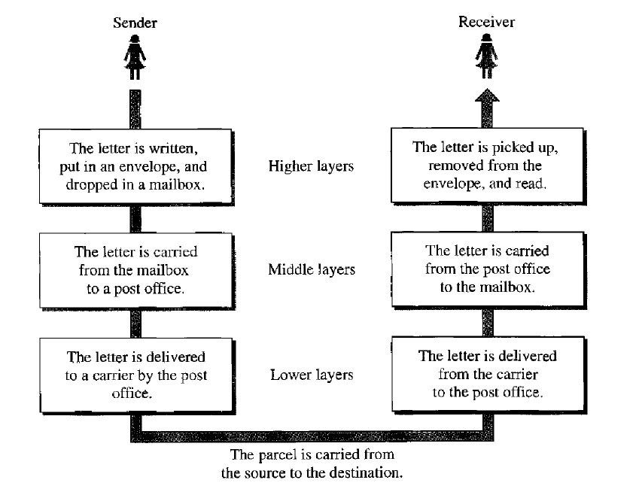
Protocol Hierarchy Example

Slide 78
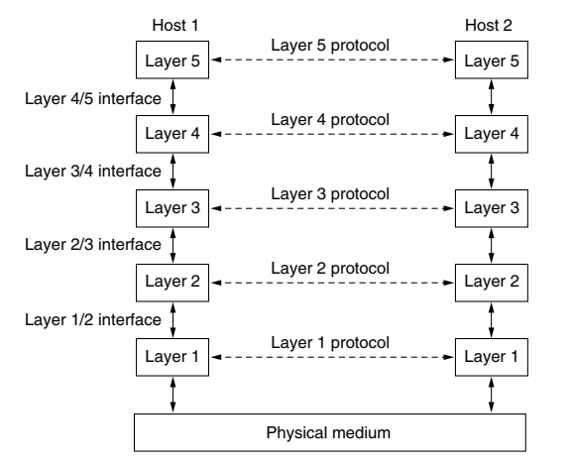
Layers, Protocols, Interfaces

Slide 79
Design Issues for Layers – Errors
Reliability is the design issue of making a network that operates correctly even though it is made up of a collection of components that are themselves unreliable
Think about the bits of a packet traveling through the network
There is a chance that some of these bits will be received damaged (0 to 1 or 1 to 0) due to electrical noise, random wireless signals, hardware flaws, software bugs and so on
How is it possible that we find and fix these errors?
One mechanism for finding errors in received information uses codes for error detection
Information that is incorrectly received can then be retransmitted until it is received correctly
More powerful codes allow for error correction, where the correct message is recovered from the possibly incorrect bits that were originally received
Both of these mechanisms work by adding redundant information

Slide 80
Design Issues for Layers – Routing
Another reliability issue is finding a working path through a network
Often there are multiple paths between a source and destination, and in a large network, there may be some links or routers that are broken
Suppose that the network is down in Germany
Packets sent from London to Rome via Germany will not get through, but we could instead send packets from London to Rome via Paris
The network should automatically make this decision
This topic is called routing

Slide 81
Design Issues for Layers – Addressing
Since there are many computers on the network, every layer needs a mechanism for identifying the senders and receivers that are involved in a particular message
This mechanism is called addressing or naming

Slide 82
Design Issues for Layers – Flow control
Another problem is how to keep a fast sender from bombarding a slow receiver with data
Feedback from the receiver to the sender is often used
This subject is called flow control
Sometimes the problem is that the network is oversubscribed because too many computers want to send too much traffic, and the network cannot deliver it all
This overloading of the network is called congestion

Slide 83
Layers in OSI
Application Layer
Presentation Layer
Session Layer
Transport Layer
Network Layer
Data Link Layer
Physical Layer
Notes:
83

Slide 84
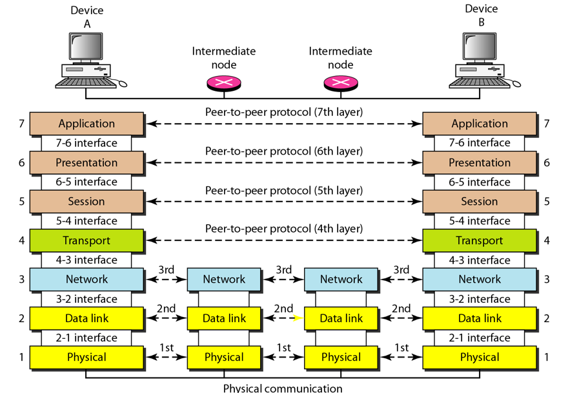
OSI Model – Interaction Between Layers

Slide 85
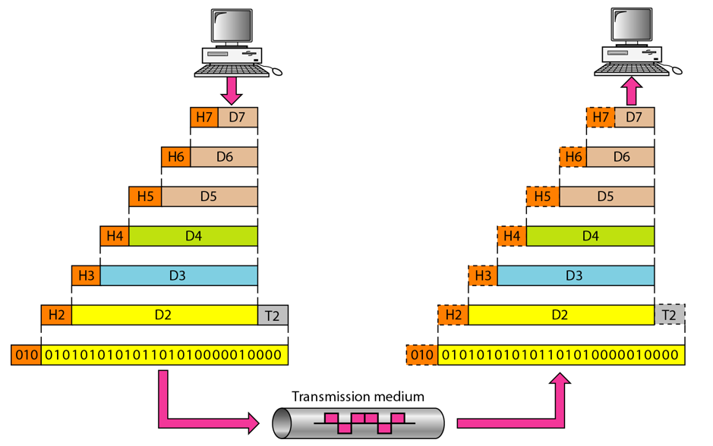
An Exchange using the OSI Model

Slide 86
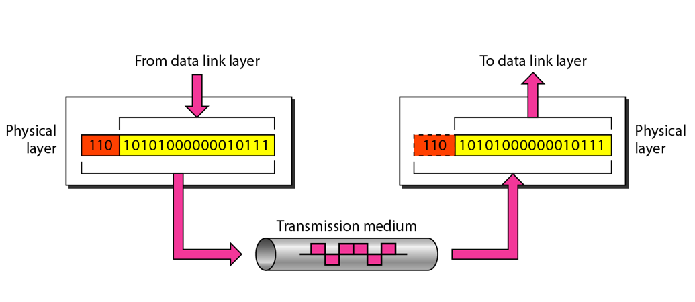
The Physical Layer

Slide 87
Physical Layer Functions
Coordination of functions required to carry a bit stream over a physical medium (Analog/digital, Serial/parallel)
Deals with mechanical and electrical specifications of the interface and transmission medium
Encoding: Representation of bits into electrical or optical
Data rate: Defines number of bits to be sent in a second (i.e. transmission rate)
Synchronization: Synchronization of the clocks of the sender and the receiver (Synchronous/Asynchronous)
Line configuration: Connection of devices to media (point-to-point or multi-point)
Physical topology: Mesh, star, ring, …
Transmission mode: Simplex, half-duplex, full-duplex

Slide 88
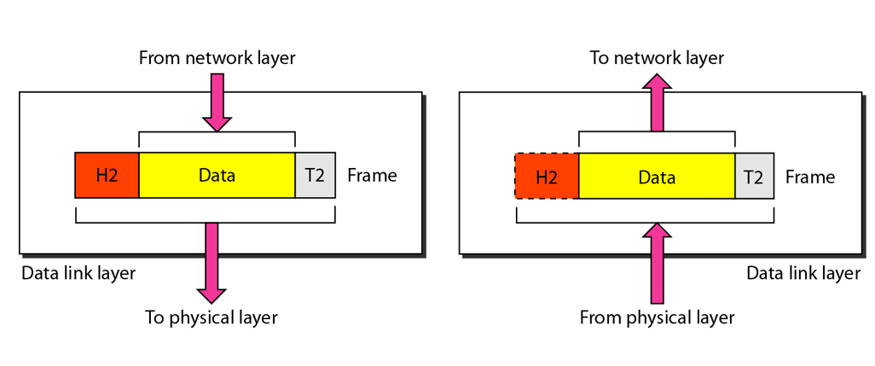
The Data Link Layer

Slide 89
Data Link Layer
Responsible for delivery of packets between two hosts connected to the same physical network (hop-to-hop – see next slide)
Cannot work across networks
Converts the raw physical layer transmission into a reliable link
Framing: Dividing bits into frames
Physical addressing: Adding sender’s and receiver’s physical addresses to the frame header
Flow control: Decide how much data to send at one go
Error control: Add trailer to the frame to take care of damaged, lost, or duplicate frames
Access control: Handle simultaneous transmissions from two or more devices

Slide 90
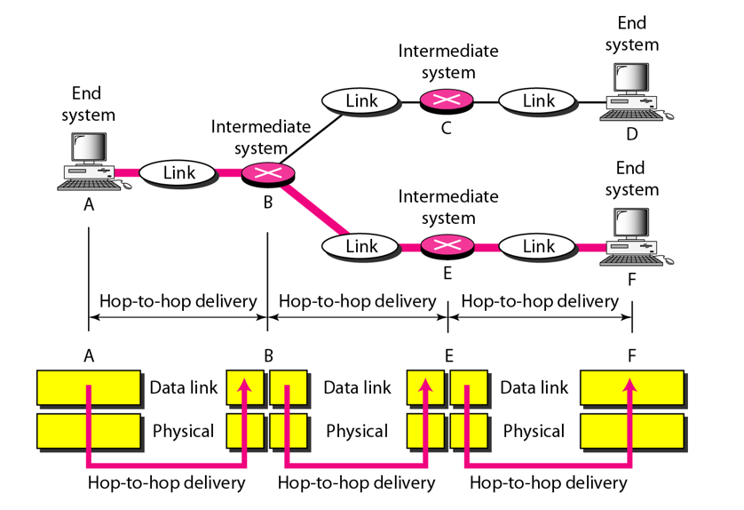
Hop-to-hop Delivery

Slide 91
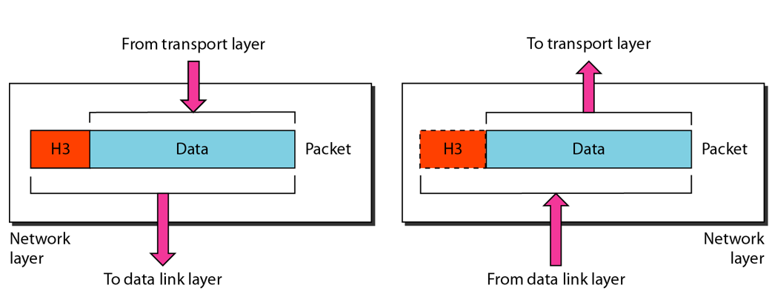
The Network Layer

Slide 92
Network Layer Functions – 1
Responsible for source-to-destination delivery of packets possibly across different networks (links)
Coordinates delivery of packets from the original sender to the final destination
In-between, data link layer takes care of hop-by-hop delivery between nodes attached to the same network

Slide 93
Network Layer Functions – 2
Logical addressing: Physical addresses are defined by data link layer to take care of addressing inside the same network. If a packet has to travel across a network to another network, physical addressing will not work. Hence, a “universal address” or a “logical address” is required. This is done at the network layer.
A header is added for this and other purposes.
Routing: When independent networks are connected to form an internetwork (or internet), i.e. a network of networks, the connecting devices (switches or routers) route the packets to the final destination. Network layer is responsible for this function.

Slide 94
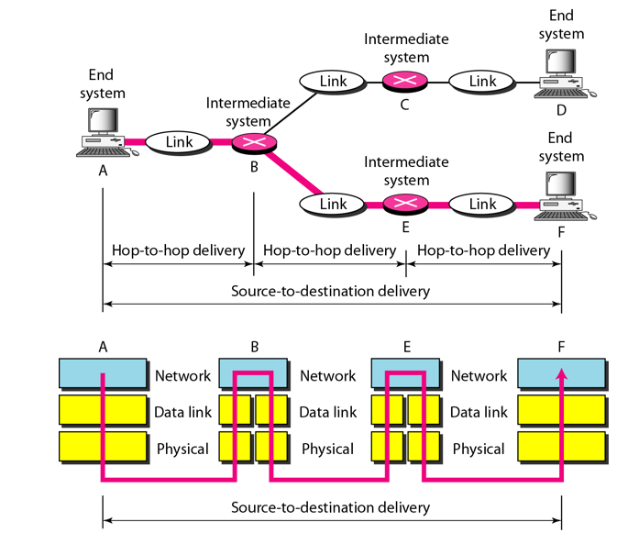
Source-to-destination Delivery

Slide 95
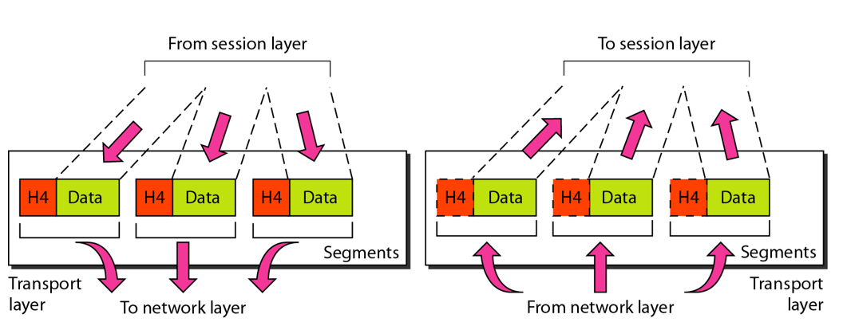
The Transport Layer

Slide 96
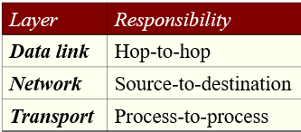
Transport Layer
Process is an application program running on a host
Network layer delivers packets from source to destination, but has no clue about the relationship between these packets
It treats each one of them as an independent packet
Transport layer takes care of ensuring that the whole message arrives from the sender to the destination
Also handles flow control and error control at the source-to-destination level

Slide 97
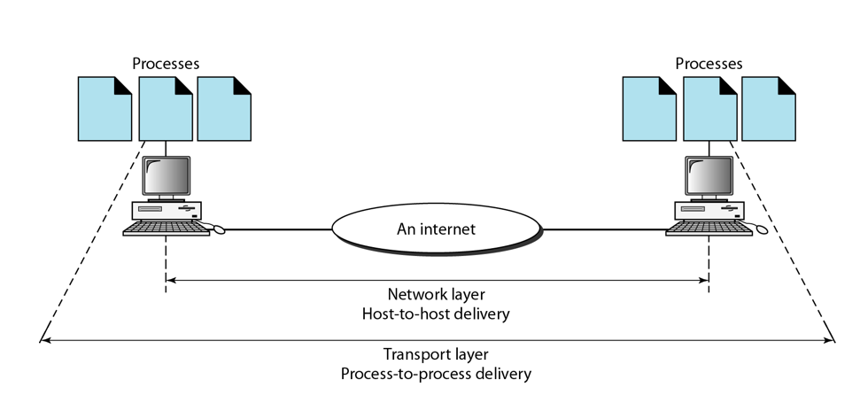
Reliable Process-to-process Delivery of a Message

Slide 98
Transport Layer
Port addressing: Ensure the right application gets packets on a computer running several applications
Segmentation and reassembly: Divide a message into segments, each bearing a segment number
Destination uses these to reassemble messages and to track loss, duplication, or sequencing problems
Connection control: Connection-oriented or connection-less
Flow control: End-to-end, not hop-to-hop
Error control: Process-to-process, not hop-to-hop
Usually uses acknowledgments and retransmissions for this

Slide 99
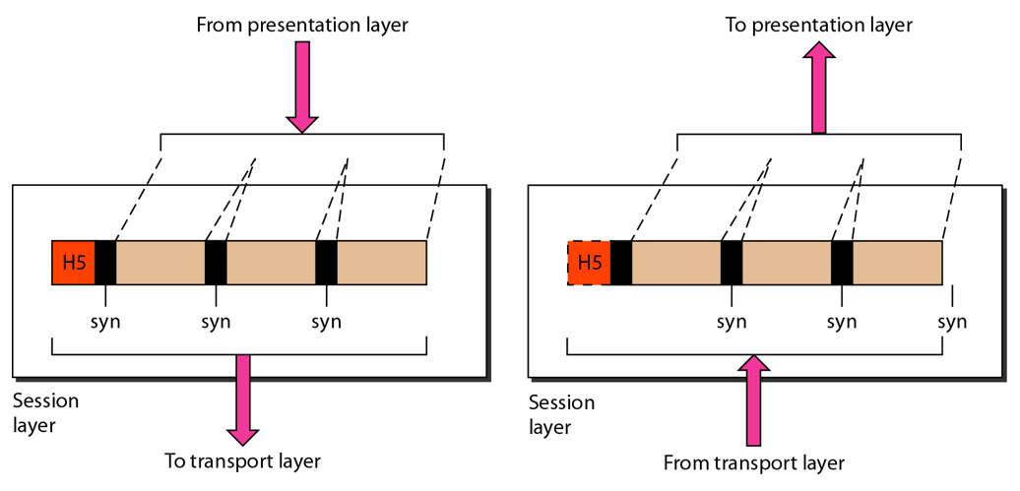
The Session Layer

Slide 100
Session Layer
Dialog control: Allows two systems to enter into a dialog (half-duplex or full-duplex)
Synchronization: Adds checkpoints to allow restart from the last checkpoint, instead of having to send the whole data once again from scratch

Slide 101
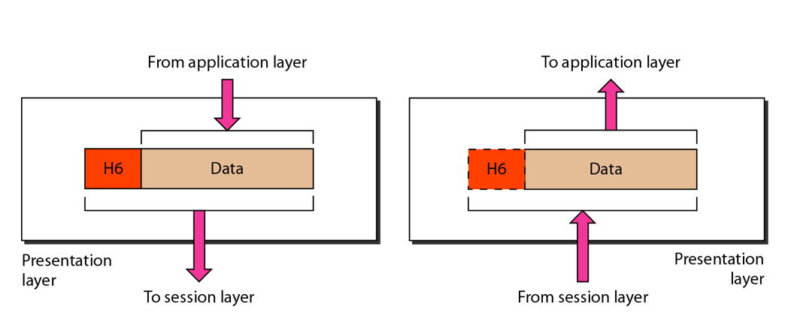
The Presentation Layer

Slide 102
Presentation Layer
Translation: Use of a common format to take care of differences (encoding, number representation etc)
Encryption: To achieve confidentiality or privacy
Compression: Reduces the number of bits needed to be transmitted

Slide 103
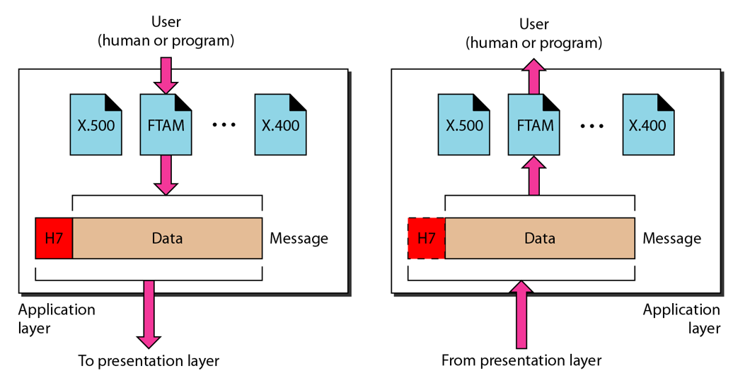
The Application Layer

Slide 104
Application Layer
Provides an “application view” to a network (e.g. email, file transmission)
Network virtual terminal: Allows a host to connect to a remote computer, as if this is a local connection
Creation of software emulation of a terminal at the remote computer
File transfer, access, and management
Mail services
Directory services

Slide 105
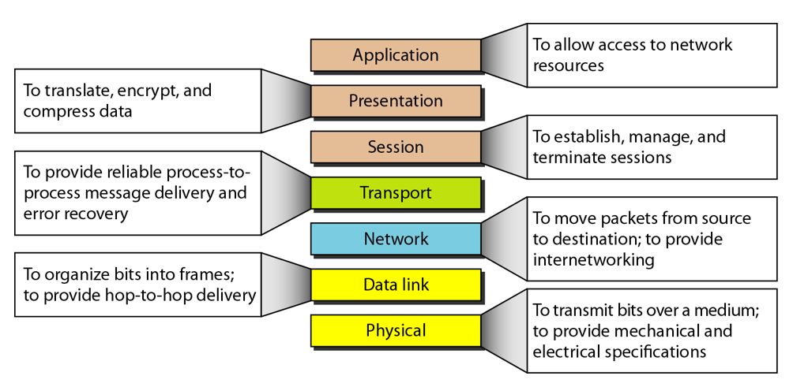
OSI Layer Summay

Slide 106
TCP/IP

Slide 107
Basics of TCP/IP
The TCP/IP protocol suite was developed prior to the OSI model
Therefore, the layers in the TCP/IP protocol suite do not match exactly with those in the OSI model
The original TCP/IP protocol suite was defined as four software layers built upon the hardware
Today, however, TCP/IP is thought of as a five-layer model with the layers named similarly to the ones in the OSI model

Slide 108
OSI versus TCP/IP
When we compare the two models, we find that two layers, session and presentation, are missing from the TCP/IP protocol suite
These two layers were not added to the TCP/IP protocol suite after the publication of the OSI model
The application layer in the suite is usually considered to be the combination of three layers in the OSI model
See diagram on the next slide

Slide 109
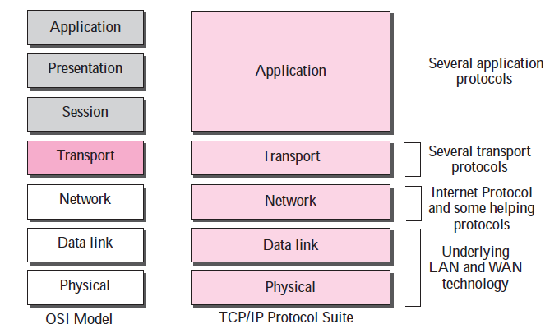
OSI versus TCP/IP

Slide 110
Physical Layer
TCP/IP does not define any specific protocol for the physical layer
It supports all of the standard and proprietary protocols
At this level, the communication is between two hops or nodes, either a computer or router
The unit of communication is a single bit
When the connection is established between the two nodes, a stream of bits is flowing between them
The physical layer, however, treats each bit individually

Slide 111
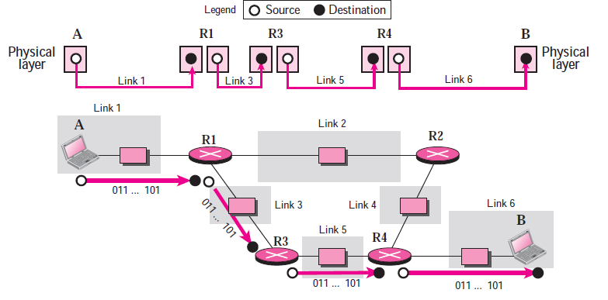
Communication at the Physical Layer

Slide 112
Data Link Layer
TCP/IP does not define any specific protocol for the data link layer either
It supports all of the standard and proprietary protocols
At this level, the communication is also between two hops or nodes
The unit of communication however, is a packet called a frame
A frame is a packet that encapsulates the data received from the network layer with an added header and sometimes a trailer
The header, among other communication information, includes the source and destination of frame
The destination address is needed to define the right recipient of the frame because many nodes may have been connected to the link
The source address is needed for possible response or acknowledgment as may be required by some protocols

Slide 113
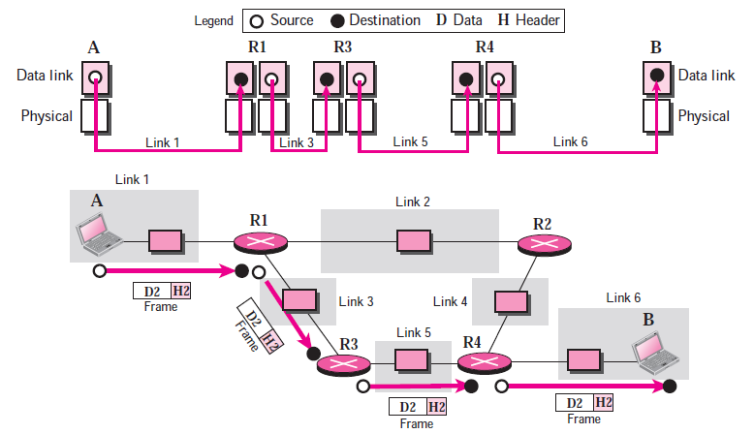
Communication at the Data Link Layer

Slide 114
Network Layer
At the network layer (or, more accurately, the internetwork layer), TCP/IP supports the Internet Protocol (IP)
The Internet Protocol (IP) is the transmission mechanism used by the TCP/IP protocols
IP transports data in packets called datagrams, each of which is transported separately
Datagrams can travel along different routes and can arrive out of sequence or be duplicated
IP does not keep track of the routes and has no facility for reordering datagrams once they arrive at their destination

Slide 115
Network Layer – More …
Note that there is a main difference between the communication at the network layer and the communication at data link or physical layers
Communication at the network layer is end to end while the communication at the other two layers are node to node
The datagram started at computer A is the one that reaches computer B
The network layers of the routers can inspect the source and destination of the packet for finding the best route, but they are not allowed to change the contents of the packet
Of course, the communication is logical, not physical
Although the network layer of computer A and B think that they are sending and receiving datagrams, the actual communication again is done at the physical level

Slide 116

Network Layer

Slide 117
Transport Layer
There is a main difference between the transport layer and the network layer
Although all nodes in a network need to have the network layer, only the two end computers need to have the transport layer
The network layer is responsible for sending individual datagrams from computer A to computer B; the transport layer is responsible for delivering the whole message, which is called a segment, a user datagram, or a packet, from A to B
A segment may consist of a few or tens of datagrams
The segments need to be broken into datagrams and each datagram has to be delivered to the network layer for transmission
Since the Internet defines a different route for each datagram, the datagrams may arrive out of order and may be lost
The transport layer at computer B needs to wait until all of these datagrams to arrive, assemble them and make a segment out of them

Slide 118

Transport Layer

Slide 119
Transport Layer Protocols
Traditionally, the transport layer was represented in the TCP/IP suite by two protocols:
User Datagram Protocol (UDP) and
Transmission Control Protocol (TCP)
A new protocol called Stream Control Transmission Protocol (SCTP) has been introduced in the last few years

Slide 120
Application Layer
The application layer in TCP/IP is equivalent to the combined session, presentation, and application layers in the OSI model
The application layer allows a user to access the services of our private internet or the global Internet
Many protocols are defined at this layer to provide services such as electronic mail, file transfer, accessing the World Wide Web, and so on

Slide 121

Communication at the Application Layer

Slide 122
Layer 2 Switching

Slide 123
Networking devices
Repeater
Bridge
Router
Gateway
Hub
Switch

Slide 124
Hub
For the original version of twisted pair Ethernet, the electronic device that served as the central interconnection was known as a hub.
Hubs were available in a variety of sizes, with the cost proportional to size.
A small hub had four or eight ports that each connected to a computer or other device (e.g., a printer).
Larger hubs accommodated hundreds of connections.

Slide 125

Hub Concept

Slide 126
More on Hub …
Electronic components in a hub emulate a physical cable, making the entire system operate like a conventional Ethernet.
For example, a computer attached to a hub uses CSMA/CD to access the network, receives a copy of each frame, and uses the address in a frame to determine whether to process or ignore the frame.

Slide 127
Layer 2 Switch
An Ethernet switch, sometimes called a Layer 2 switch is an electronic device that resembles a hub.
Like a hub, a switch provides multiple ports that each attach to a single computer, and a switch allows computers to send frames to one another.
The difference between a hub and a switch arises from the way the devices operate: a hub operates as an analog device that forwards signals among computers, while a switch is a digital device that forwards packets.
We can think of a hub as simulating a shared transmission medium, and think of a switch as simulating a bridged network that has one computer per LAN segment. (See figure on the next slide)

Slide 128

Switched LAN

Slide 129
Hub versus Switch
The main advantage of using a switched LAN instead of a hub is parallelism.
Although a hub can only support one transmission at a time, a switch permits multiple transfers to occur at the same time, provided the transfers are independent (i.e., only one packet is being transferred to a given port at a given time).
Thus, if a switch has N ports connected to N computers, N/2 transfers can occur at the same time.

Slide 130
More on Switch
A switch does not contain separate bridges.
Instead, a switch consists of an intelligent interface attached to each port and a central fabric that provides simultaneous transfer between pairs of interfaces.
An interface contains a processor, memory, and other hardware needed to accept an incoming packet, consult a forwarding table, and send the packet across the fabric to the correct output port. The interface also accepts packets from the fabric, and transmits them out the port.
Most important, because it contains memory, an interface can buffer arriving packets when an output port is busy. Thus, if computer 1 and computer 2 send packets to computer 3 simultaneously, either interface 1 or interface 2 will hold a packet while the other interface transmits. (See figure)

Slide 131

Switch Architecture

Slide 132

Collision domain concept
All devices that use the same physical media and listen to each frame are considered to be in the same collision domain.
This means that only one device can transmit at any given time, and any other device on the network segment must synchronize with the signal and extract the frame.

Slide 133

Spanning Tree Protocol (STP)
To increase reliability, redundant links can be used between bridges.
Let us consider two parallel links between a pair of bridges.
This design ensures that if one link is cut, the network will not be partitioned into two sets of computers that cannot talk to each other.

Slide 134
Spanning Tree Protocol (STP) – Problem
This design solves one problem, but can create another – loops.
Suppose host A sends a frame F0 that reaches bridge B1. The bridge will send copies of this frame to all its other ports, using the usual flooding concept.
Since there are two links between B1 and B2, two copies of the frame, called F1 and F2 will reach B2.
B2 does not know F1 and F2 are copies of each other, so it copies them as F3 and F4 and floods, meaning they will also go back to B1.
B1 again sees two new frames with an unknown destination and repeats the earlier steps; B2 does the same – this will go on and on

Slide 135
Spanning Tree Protocol (STP) – Solution
The solution to this difficulty is for the bridges to communicate with each other and overlay the actual topology with a spanning tree that reaches every bridge.
In effect, some potential connections between bridges are ignored in for constructing a virtual loop-free topology that is a subset of the actual topology.
Let us consider a spanning tree containing 5 bridges.

Slide 136

Spanning Tree Example
There are some redundant connections between the bridges so that frames will be forwarded in loops if all of the links are used.
This topology can be thought of as a graph in which the bridges are the nodes and the point-to-point links are the edges.
The graph can be reduced to a spanning tree, which has no cycles by dropping the links shown as dashed lines.
Using this spanning tree, there is exactly one path from every station to every other station.
Once the bridges have agreed on the spanning tree, all forwarding between stations follows the spanning tree.
Since there is a unique path from each source to each destination, loops are impossible.

Slide 137
Construction of the spanning tree – 1
The bridges must first choose one bridge to be the root of the spanning tree.
To make this choice, they each include an identifier based on their MAC address in the configuration message, as well as the identifier of the bridge they believe to be the root.
MAC addresses are installed by the manufacturer and guaranteed to be unique worldwide, which makes these identifiers convenient and unique. The bridges choose the bridge with the lowest identifier to be the root. After enough messages have been exchanged to spread the news, all bridges will agree on which bridge is the root.
In our example, bridge B1 becomes the root.

Slide 138
Construction of the spanning tree – 2
Next, a tree of shortest paths from the root to every bridge is constructed. Here, bridges B2 and B3 can be reached from bridge B1 in a single hop, that is a shortest path.
Bridge B4 can be reached in two hops, via either B2 or B3. To break this tie, the path via the bridge with the lowest identifier is chosen, so B4 is reached via B2.
Bridge B5 can be reached in two hops via B3.
To find these shortest paths, bridges include the distance from the root in their configuration messages. Each bridge remembers the shortest path it finds to the root. The bridges then turn off ports that are not part of the shortest path.
Although the tree spans all the bridges, not all the links (or even bridges) are necessarily present in the tree. This happens because turning off the ports prunes some links from the network to prevent loops. Even after the spanning tree has been established, the algorithm continues to run during normal operation to automatically detect topology changes and update the tree.

Slide 139
IPv6

Slide 140

IPv6 addressing
An IPv6 address is 128 bits (16 bytes) long, which is 4 times that of IPv4
Instead of the dotted decimal notation, in IPv6, we use colon hexadecimal notation
Here, we have 8 sections of 2 bytes each, each 2 bytes represented as 4 hex digits – hence we have 32 hex digits for an IPv6 address
Zero compression can be used

Slide 141

IPv6 addressing
IPv6 uses hierarchical addressing
It is classless and uses CIDR notation
Example

Slide 142

IPv6 packet format
Each packet is composed of a mandatory base header followed by the payload.
The payload consists of two parts: optional extension headers and data from an upper layer.
The base header occupies 40 bytes, whereas the extension headers and data from the upper layer contain up to 65,535 bytes of information.

Slide 143

Base header

Slide 144
Base header field
Version. This 4-bit field defines the version number of the IP. For IPv6, the value is 6.
Traffic Class. This 8-bit field is used to distinguish different payloads with different delivery requirements. It replaces the service class field in IPv4.
Flow label. The flow label is a 20-bit field that is designed to provide special handling for a particular flow of data.
Payload length. The 2-byte payload length field defines the length of the IP datagram excluding the base header.
Next header. The next header is an 8-bit field defining the header that follows the base header in the datagram. The next header is either one of the optional extension headers used by IP or the header of an encapsulated packet such as UDP or TCP. Each extension header also contains this field. Note that this field in version 4 is called the protocol.
Hop limit. This 8-bit hop limit field serves the same purpose as the TTL field in IPv4.
Source address. The source address field is a 16-byte (128-bit) Internet address that identifies the original source of the datagram.
Destination address. The destination address field is a 16-byte (128-bit) Internet address that usually identifies the final destination of the datagram. However, if source routing is used, this field contains the address of the next router.

Slide 145
Software Defined Network (SDN)

Slide 146
Traditional Network Management
Use SSH to manage one device at a time
Command-line interface
Very slow, error-prone (accidental errors, different sysadmins may configure differently)
Later some GUI tools were available, but they were slow and inefficient

Slide 147
Network Automation
Device configuration
Initial device provisioning
Software version control
Collecting statistics from devices
Compliance verification
Reports
Troubleshooting

Slide 148
Network Automation Benefits
Enhances automation, reduces manual efforts
Human errors and typos are avoided
Scalable- not one device at a time
Version/configuration control

Slide 149
Automation Options
Python scripts
NETCONF
RESTCONF
Ansible
Puppet
SDN
Cisco DNA Center
Note: Not all methods are supported by all the devices

Slide 150
SDN on Routers
SDN separates data and control planes
Three planes will be created
Data plane – Traffic of data which is forwarded through the device.
Control plane – Makes decisions about how to forward traffic. Control plane packets such as routing protocol or spanning tree updates originate or terminate on the router itself. Runs in a separate centralized SDN controller.
Management plane – The device is configured and managed here. E.g. by using Telnet or SSH or via a GUI using HTTPS, etc.

Slide 151
OpenDaylight
https://www.youtube.com/watch?v=rAm48gVv8_A
https://youtu.be/YN_nK3w51Ag

Slide 152
Access Control Lists (ACL)

Slide 153
Access Control Lists
Access Control List (ACL) is a list of instruction that we can apply to a router’s interface
This list tells the router which packets to accept and which ones to deny
Parameters for acceptance and denial
Source address
Destination address
Port numbers

Slide 154

ACL Usage
An ACL filters network traffic by controlling whether routed packets are forwarded or blocked at the router’s interfaces
A router examines the conditions specified in the ACL to decide whether to forward or block packets

Slide 155
ACL Creation and Usage
For one protocol, there should be one ACL
Example: If a router interface is configured for IP and AppleTalk, we will need two ACLs, one per protocol
Reasons for creating an ACL
Limit network traffic and improve its performance
Provide traffic flow control
Provide basic security to a network
Decide what traffic to allow/block at the router interface level
Packet filtering

Slide 156
ACL – Order of statements
It is very important to place the statements inside an ACL in a correct order
When deciding whether to route or block a packet, the router software tests the packet against the condition in each statement in the order in which it is created, sequentially
When a match is found, no more statements are checked
If we need to add some statements to an existing ACL, we must delete the ACL and recreate it with the new statements

Slide 157
Standard Numbered ACL
The standard access list has a number range from 1-99 and 1300-1999.
It specifies permit/deny traffic from only a source IP address.

Slide 158
Extended ACL
Although there are times when we only need to filter traffic based on the source address, more often than not we will need to match traffic with a higher level of detail.
An option for more precise traffic-filtering control would be an extended ACL.
Here, both the source and destination address are checked. In addition, you also have the ability to specify the protocol and optional TCP or UDP port number to filter more precisely.
Extended ACL range is 100-199 and 2000-2699.

Slide 159

Application Port Numbers and ACL Keywords

Slide 160

ACL Example

Slide 161
Examples of ACL Commands
10.10.10.10 = A specific host
0.0.0.0 = Means this is a host, not a network
10.10.10.0 = Network
0.0.0.255 = All hosts on that network
access-list 1 deny 10.10.10.10 0.0.0.0
access-list 1 permit 10.10.10.0 0.0.0.255
Default wildcard mask for a standard ACL is 0.0.0.0, which means an individual host. So the first line will deny access to the host 10.10.10.10. The second line will allow access to all the other hosts.
access-list 100 permit tcp host 10.1.1.1 host 10.1.2.1 eq 80
Permits http traffic from host 10.1.1.1 to host 10.1.2.1
access-list 100 deny ip host 192.168.1.1 host 192.168.3.1
access-list 100 permit ip any any
The first statement denies all application traffic from host-1 (192.168.1.1) to web server (host 192.168.3.1). The ip keyword refers to Layer 3 and affects all protocols and applications at layer 3 and higher. The last statement is required to permit all other traffic not matching.

Slide 162
Examples of Extended ACL Commands
access-list 100 permit tcp 192.168.1.0 0.0.0.255 any eq telnet
access-list 100 permit ip any any
The first statement permits Telnet traffic from all hosts assigned to subnet 192.168.1.0/24 subnet. The tcp keyword is Layer 4 and affects all protocols and applications at Layer 4 and higher. The permit tcp configuration allows the specified TCP application (Telnet). The any keyword allows Telnet sessions to any destination host. The last statement is mandatory and required to permit all other traffic.

Slide 163
Examples of Extended ACL Commands
access-list 100 permit ip 172.16.1.0 0.0.0.255 host 192.168.3.1
access-list 100 deny ip 172.16.2.0 0.0.0.255 any
access-list 100 permit ip any any
The first ACL permits only hosts assigned to subnet 172.16.1.0/24 access to all applications on a server (192.168.3.1)
The second statement denies hosts assigned to subnet 172.16.2.0/24 access to any server. That would include any additional hosts added to that subnet and any new servers added.
The last ACL statement is required to permit all other traffic not matching previous filtering statements.

Slide 164

Mapping of port number to application
access-list 100 deny tcp any host 192.168.1.1 eq 21
access-list 100 permit ip any any
Result: Deny all FTP traffic from any subnet that is destined for server-1.

Slide 165
Example of Extended ACL Commands
Write a command to allow telnet traffic from host 10.1.1.1 to 10.1.2.1
Answer: access-list 100 permit tcp host 10.1.1.1 host 10.1.2.1 eq 23
What access list permits all TCP-based application traffic from clients except HTTP, SSH and Telnet?
Answser: access-list 100 permit tcp any any neq 22,23,80
What access list denies all TCP-based application traffic from clients with ports higher than 1023?
Answer: access-list 100 deny tcp any any gt 1023

